Slide 1

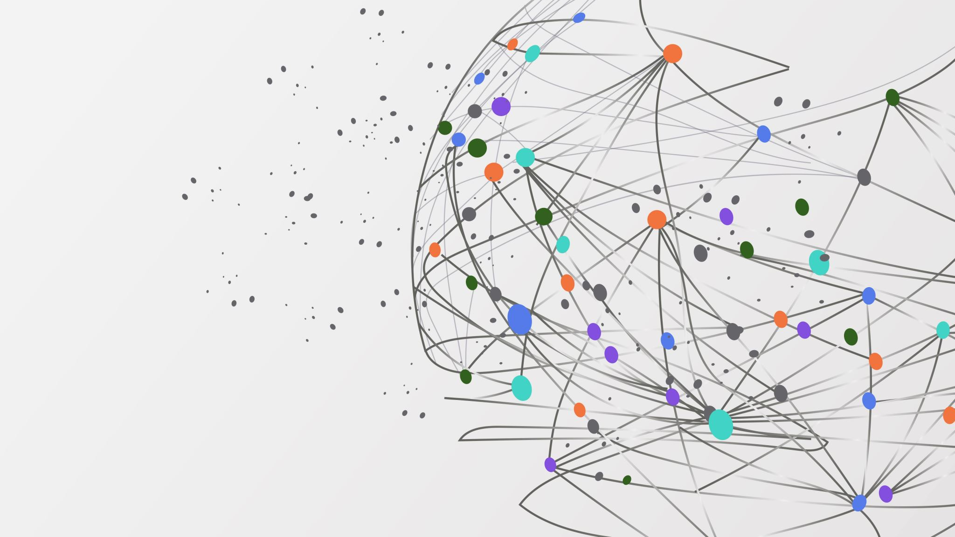
Public Disclosure Of Security Problems
Mahmoud Moustafa
3648276

Slide 2
Software Security Problems
Why software security problems are important
Assessment of the quality of a software system.
How security issues can affect users’ perceptions

Slide 3
The Different Views
Calendar View
Operational View

Slide 4
Steps to fixing software security issues
Automation Framework Creation
Creation and evaluation of a state-based process model
Creation of a security sub-models

Slide 5
Data Collection
The scattered security data problem
Toolset was created to collect data

Slide 6
Statistics
Between 0.05 and 5% of collected issues are security related.
35% of which have open exploits.
Only 1.3% of security issues encounter public exploits after being made public.
34% of issues receive exploits even before developers are aware of them.

Slide 7
Process Modeling
Reaction model to security issues.
Capable of making depictions.
Emphasizes roles and usage perspectives

Slide 8
Predictive Modeling
Helps in issue prediction
Transitions in the overall model
Classical reliability models may effectively forecast
Bayesian disclosure model describes the variability in operational profiles, the impact of cyber attacks, among other things.

Slide 9
The Bayesian model
Two kinds of security disclosures:
The first includes problems that come with solutions
The second is one that is not coupled with a solution.

Slide 10
Security flaws
Security “flaws” suggest criminal intent
Exploitation that will aggravate a relatively harmless security issue may take place.
After the exposure of the flaw, attacks will intensify.

Slide 11
Security problems
Often subtle
Most likely will not appear until a correlated set of input is present.
Can slow down the system
Can provide illegal access to the system and its contents
The analysis of the data revealed a declining trend in the reported security issue count

Slide 12
Bayesian model
Data showed that the Bayesian model’s accuracy matched the predicted accuracy
This shows that the model agrees with the collected data
Using the median relative error showdc that it is possible to anticipate security problem disclosure occurrences.

Slide 13
Full vs limited disclosure
Full-disclosure software products required more time to resolve security flaws than limited-disclosure software products.
Limited-disclosure solutions would have a bigger overall user impact

Slide 14
Four security failure Simulation Cases
In the first case, viruses propagate when a high percentage of operating systems are weak.
Full disclosure browsers employed automatic patching.
Limited disclosure browsers employed non-automatic patching.
Number of systems impacted by security flaws varied significantly.
Limited disclosure affected more systems than full-disclosure browsers

Slide 15
Four security failure Simulation Cases
In the second case, attackers target users for exploits until all the targets installed fixes.
Full disclosure browsers received patches before limited disclosure browsers
More systems are impacted by limited disclosure browsers than by full disclosure browsers

Slide 16
Four security failure Simulation Cases
In the third case, it was assumed that security failures would last for a month for both.
The average number of impacted systems with limited-disclosure browsers was discovered to be higher than those with full-disclosure browsers.
In the fourth case, the failure periods for popular security threats were observed
those failure periods turned out to be approximately a week.
The number of systems with limited-disclosure browsers was higher than those with full-disclosure browsers.

Slide 17
Early Disclosure drawbacks
Early disclosure has its drawbacks:
That developers can give themselves more time than they should in order to fix the issue.
It is very hard to determine the conditions that will make early disclosure a good policy in this case.
Calculating the number of users that need to take precautions can go wrong very easily.
In most cases, only 18% of users take the needed measures.

Slide 18
Why not to disclose security problems publicly
Most people are technologically illiterate.
Public disclosure of security problems will open the door for more attacks
Attackers would most likely target the users, even after an issue has been patched.

